Slide 1

Will they claim it ?

Slide 2
Problem Statement
Many companies selling tickets or travel packages,give consumers the option to purchase travel insurance, also known as travelers insurance.
Goal of this project is to predict whether insurance policies are claimed or not based on the given features.Travel insurance will have coverage for travelers concerns,including flight delays,trip cancellation or baggage loss.
Insurance firms take risks on their customers. A very significant part of the insurance sector is risk management. To build profiles of high and low insurance risks, insurers consider almost all the quantifiable factors.

Slide 3

Other Related Problem
After this stage when an insurance company has to decide whether a claim is legitimate or not, there might be problems here
If a claim is misclassified then company loses money. It is giving money to a customer who in fact doesn’t deserve it
In the other case it denies money to someone whose claim is legitimate and that customer might sue the insurance company on the solid grounds

Slide 4

Who are Stakeholders? Who will benefit from the findings?
Insurance Underwriter
Head of claim Department
Head of Marketing Department
Head of Finance Department

Slide 5
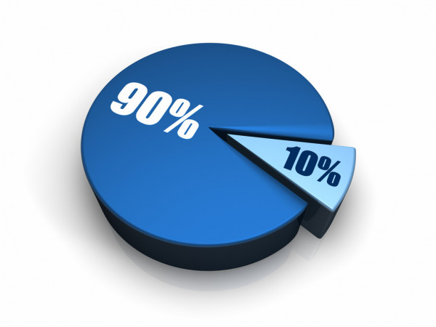
Example
Low Risk
affordable premium
High risk
High premium

Slide 6

Exploratory Data Analysis

Slide 7
Dataset Description
The training dataset consists of data corresponding to 52310 customers and the test dataset consists of 22421 customers. Following are the features of the dataset
Feature Name | Feature Description | Feature Data Type
Agency | Name of agency | Categorical
Agency Type | Type of travel insurance agencies | Categorical
Distribution Channel | Distribution channel of travel insurance agencies | Categorical
Product Name | Name of the travel insurance products | Categorical
Duration | Duration of travel (In Days) | Continuous
Destination | Destination of travel | Categorical
Net Sales | Amount of sales of travel insurance policies | Continuous
Commission | The commission received for travel insurance agency | Continuous
Age | Age of insured | Continuous

Slide 8
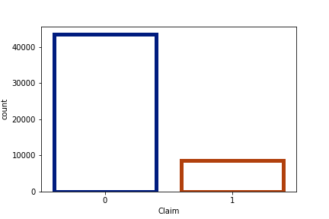
How many claims were made?
Observation
Data is Imbalanced as the number of customers who have not made any claim is higher than the number of customers who have made claim.
To make payment of claims more affordable for the company, we need to pool low risk claim. I.e customers who have low probability of claiming in the future.
43590
8720

Slide 9
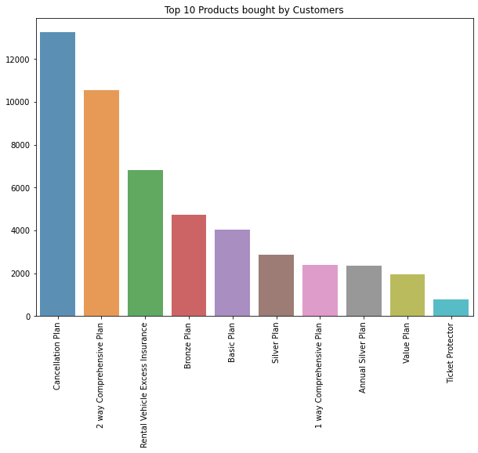
Which are the top 10 product bought by the customer?
Observation
Cancellation Plan 13254
2 way Comprehensive Plan 10555
Rental Vehicle Excess Insurance 6813

Slide 10
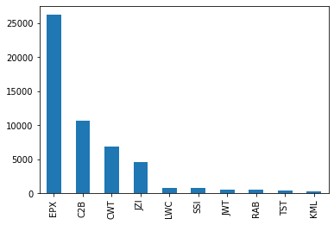
Which are the top agencies preferred by customers ?
EPX is the most preferred agency followed by C2B, CWT and JZI

Slide 11
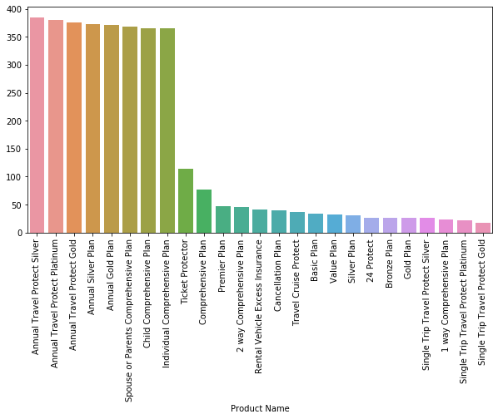
Product bought by the customer according to Duration.
Observation
Annual Travel Protect Silver
384.804
Annual Travel Protect Platinum
380.26
Annual Travel Protect Gold
375.29
According to Distribution top 8 Products are mostly uniformly distributed.

Slide 12
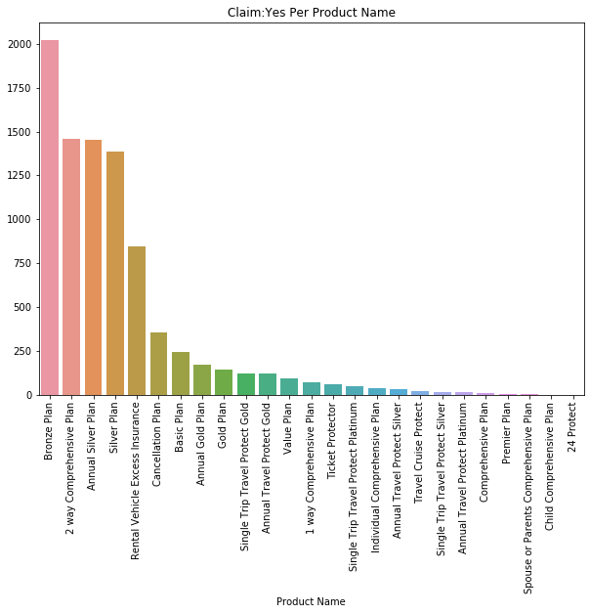
Which Product has the highest claims as Yes?
Observation
Bronze Plan
2020
2 way Comprehensive Plan
1457
Annual Silver Plan
1451

Slide 13
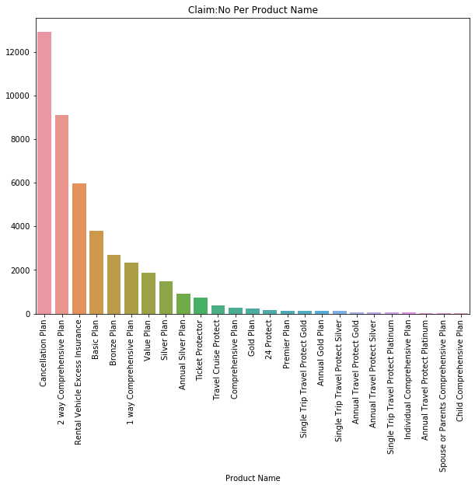
Which Product has the highest claims as No?
Observation
Cancellation Plan
12899
2 way Comprehensive Plan
9098
Rental Vehicle Excess Insurance
5965

Slide 14
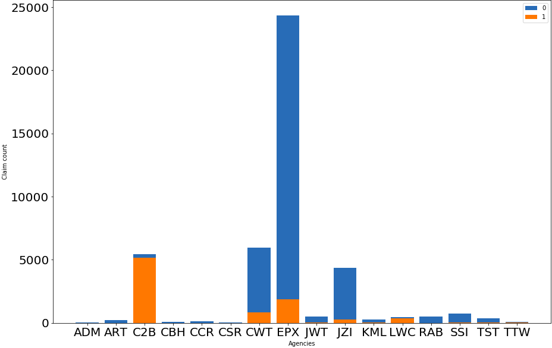
Agencies distribution according to Claim and no Claim.
Observation
EPX agency has more biased Not Claimed data than Claimed data the same is with CWT and JZI.
JWT, TST, ART, ADM, CBH,CSR, RAB and CCR has no data of Claimed.

Slide 15
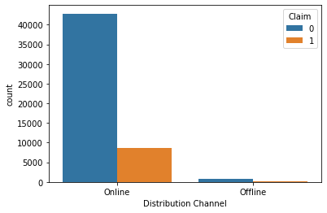
Distribution of Distribution Channel according to Claim.
Observation
As it can be observed from the distribution that people mostly prefer Online distribution channel than offline. So company should try to make their online mode more attractive by getting feedback from the ones who are using Offline.

Slide 16
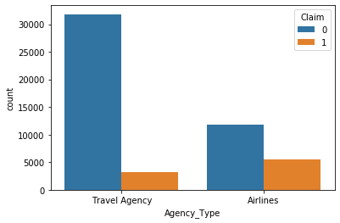
Distribution of Claim according to Agency type.
Observation
Population of people traveling through travel agency are more than that of airlines but we can see that instead of that insurance claim rate is more in airlines as compared to travel agency.

Slide 17


Slide 18
Pipeline
Initially we have dataset with 11 features and 52310 data points in our training dataset and test data of around 22421 data points.
No missing Values, Pre-cleaned data
As we do have 11 features from which Agency has 16 different categories and Destination has 97 different categories so we created 2 new KPIs .
Sorted Agency according to net sales. Agency with highest net sales at the top followed by others.
C2B,EPX,CWT,JZI & LWC these are the major players. Rest belongs to others
Countries clustered into Continents.
There are some transcontinental countries.
In age distribution we found that there were 2 people with age 0.Strange!..
737 people with age more than 100 ------> mean of the Age column.
Replaced -ve duration ------> 0
Standard scaled the numeric data
Labeled encoding and One hot encoding(Product Names) for categorical data

Slide 19

Model Building

Slide 20
Models and Approaches
We tried 6 different models:
Logistic Regression
Decision Tree
Random Forest
Bagging Classifier
Gradient Boosting Classifier
XGBoosting Classifier
We split the data into training and testing data with testing data size being 30%
We used Cross Validations = 3 for almost all the hyperparameter tuning parts
Major Hyperparameters used for tuning: n_estimators, max_depth, min_leaf_sample, learning_rate, scale_pos_weight, criterion, class_weight

Slide 21
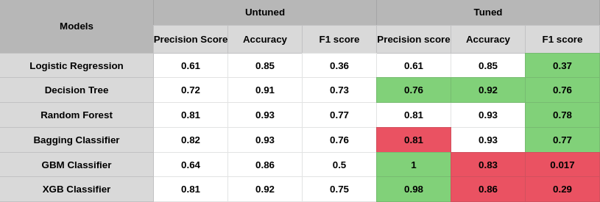
Models and the scores (No data Balancing):
We first trained the untuned models on the training data and then we trained the models by hyperparameter tuning. Following are the scores we got for different models we trained the data on:-

Slide 22
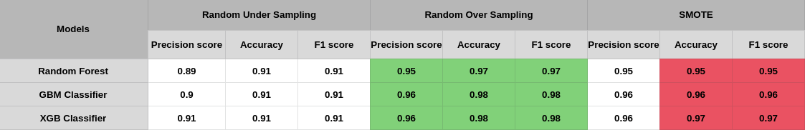
Models and Scores (Balanced Data):
Here we tried balancing the data using three different techniques as Random Under Sampling, Random Over Sampling and SMOTE and here are the scores we achieved:

Slide 23
Final Results:
Gradient Boosting Classifier without any data balancing and n_estimators=80, learning_rate=0.01, max_depth=5
Problem - F1 score is 0.17
Gradient Boosting is a greedy algorithm, it overfits the data quickly and that might be the case here.
After data balancing and XGBoost is our best bet. This is the model which supposedly going to have high F1 score and has precision score around 0.95 after data balancing by Random Oversampling.

Slide 24
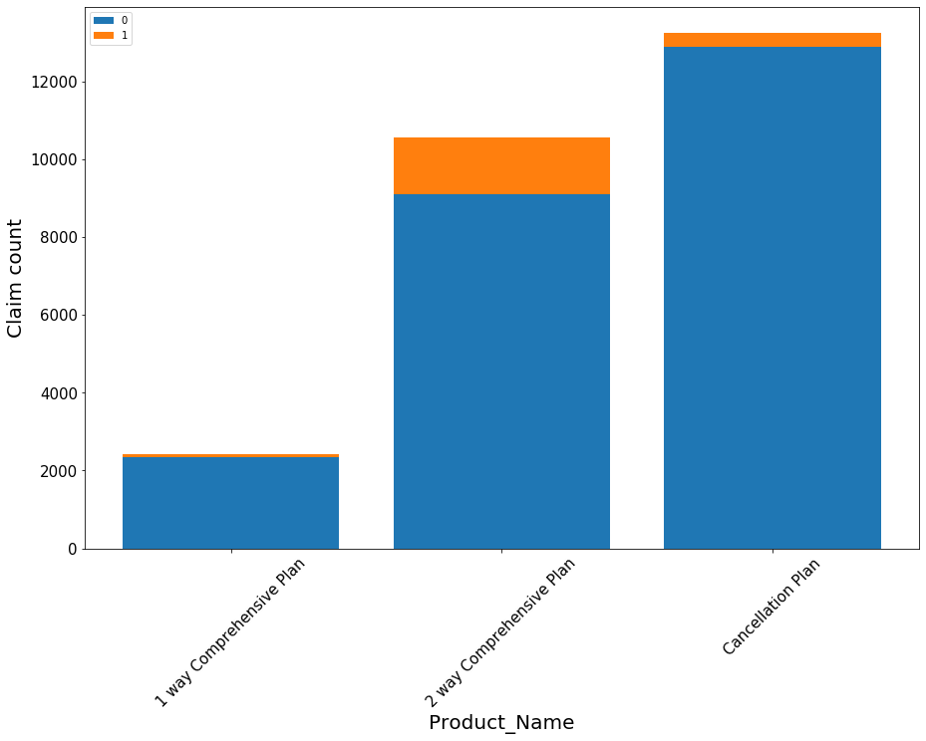
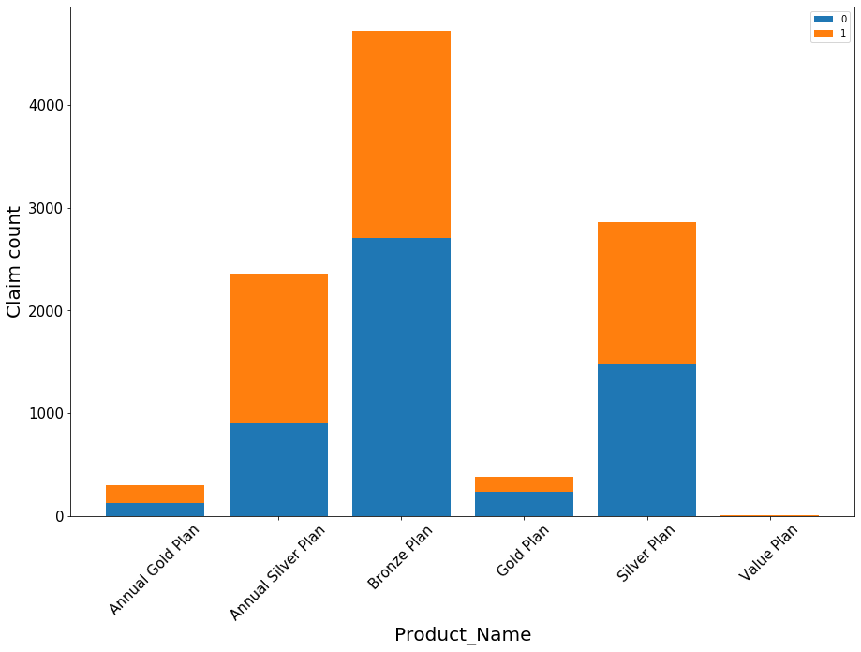
EPX C2B

Slide 25
Insights & Decisions
The largest share of net sales for travel agency shows that they have a huge customer base when compared to airline agencies but still their average sales is lower than that of airline agency. So they should focus more on acquiring customers who opt for airline insurance.
For both airline and travel agency only few of the products generates maximum of their revenue so either they can drop the low performing products or they need to revisit their product portfolio to do some needful changes so that it can attract more customers.

Slide 26
Insights & Decisions
In spite of being the ruler of the market in terms of number of customers, EPX has 2nd best Net sales, from this we might conclude that the premium offered by EPX might be lesser as compared to the C2B which has the highest Net Sales but lesser number of customers as compared to EPX
From the graphs of ‘product names vs claim counts’ we can observe that the major product plans of EPX have lesser claims to non claims cases but, in the case of C2B the number of claims to non claims cases is higher

Slide 27


